Slide 1

Neuro-Symbolic Robotics Planning via Prompt Engineering
By
Navya Pasupureddi
MS Information Technology

Slide 2


Problem Statement
Modern robots often make uncertain or incorrect decisions because neural models lack reliable commonsense reasoning. This project tests whether prompt engineering improves local LLM performance and explores the use of symbolic rules
Scenario A:
A wet umbrella should not be placed on wooden floors. A robot should guess how to place it on a balcony or drying rack.

Slide 3
Methodology
I evaluated Zero-Shot, Few-Shot, and Chain-of-Thought prompting strategies on the Commonsense QA dataset to measure reasoning performance in locally deployed language models.
Zero-Shot
Few-Shot
Chain-of-Thought(CoT)
The model answers the
question directly without
any examples or guidance.
The first 2-3 solved examples
of the question are provided
to guide the logic of the model.
The model is to generate
step-by-step reasoning before
producing a final answer.

Slide 4
Experimental Setup
The Dataset
Models
Commonsense QA
Qwen2.0.5b
A dataset of 9,741 multiple choice questions
that require common sense reasoning
beyond simple text context
Mistral
Infrastructure
Inference Engine: Ollama
Pipeline: Python-based extraction

Slide 5
The Pipeline
Data Loading
Prompt Generation
Loaded the Commonsense QA dataset and random sample subset for evaluation.
Created zero-shot, few-shot and COT prompts based on the current test configuration.
Local Inference
Analysis
Query the local LLM via the Ollama
API and analyze specific A/B/C/D/E tokens from the output.
Calculated accuracy metrics and visualized comparative performance across strategies.

Slide 6
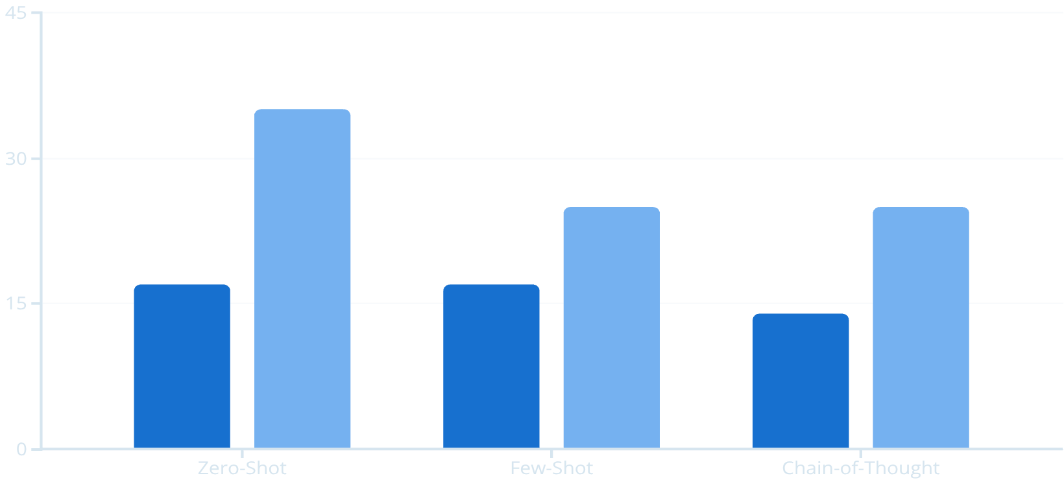
Results
qwen2 (0.5b)
Mistral

Slide 7

Future Work
Future developments will concentrate on increasing capacity, lowering restrictions, and enhancing clarity in real-world situations.
Error analysis
Prompt Compression
Creating techniques that automatically identify reasoning mistakes, inconsistencies, and failure modes in a variety of jobs.
Prompting in Multiple Modes
Finding methods for cutting prompts—particularly CoT—while maintaining the quality of reasoning and reducing the cost of deduction.
Checking domain ability by applying Zero-Shot, Few-Shot, and CoT techniques to complex tasks (vision–language, audio–text).

Slide 8

References & Tools
Commonsense QA: Hugging face
Qwen2: Alibaba Cloud, 2024
Mistral: Mistral AI, 2024
Tools:
Ollama (Local LLM Inference)
Jupyter Notebook Environment

Slide 9

THANKYOU

